Slide 1

Formula 1 Race Data 1950 - 2022
IST Databases and Data Mining
Leon Keating
Nele Kirsch

Slide 2

General Presentation
Formula One race data from 1950 – 2022
Drivers and Constructors
Circuits
Races
Results (drivers and constructors)
Sprints, Lap Times, Qualifying, Pit Stops
https://commons.wikimedia.org/wiki/File:Kaggle_logo.png

Slide 3
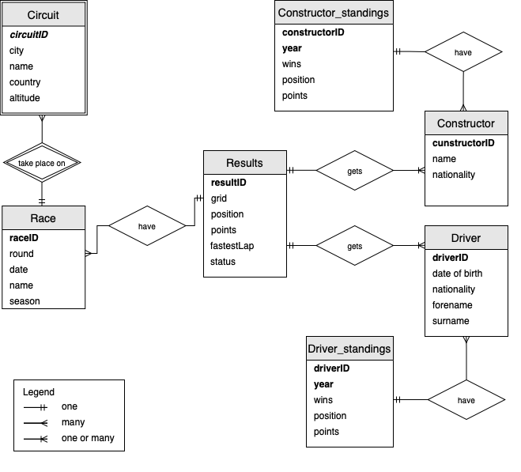
ER + Comments of entity

Slide 4
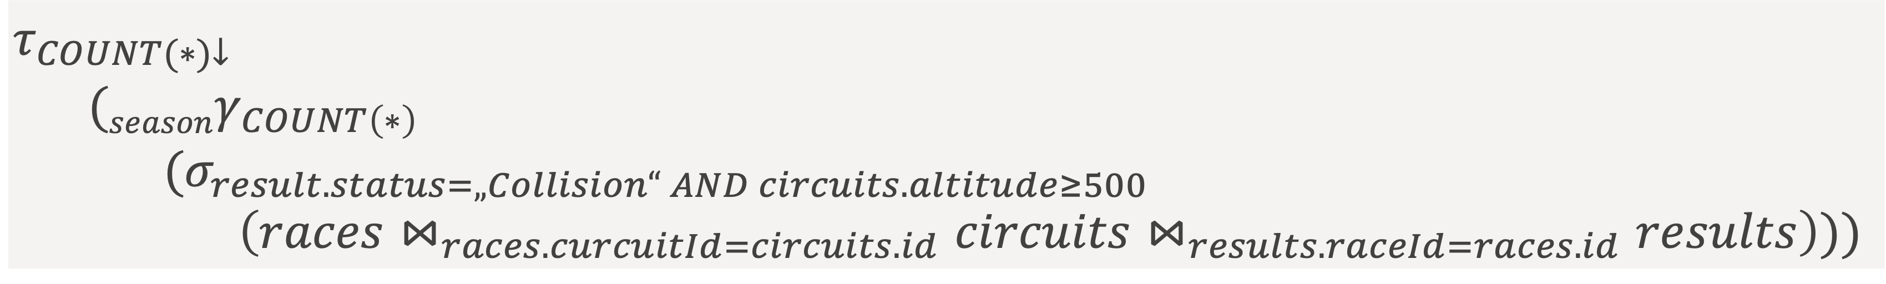
Example of SQL + RA
SELECT races.season, COUNT(*) FROM races
INNER JOIN circuits
ON races.circuitID = circuits.ID
INNER JOIN results
ON results.raceID = races.ID
WHERE results.status = ‘Collision’ AND circuits.altitude >= 500
GROUP BY races.season
ORDER BY count DESC
Seasons with the most collisions at an altitude over 500m
$$τ_{COUNT(∗)↓}$$
$(seasonγ_{COUNT\left(∗\right)}$
$(σ_{result.status=„Collision“ AND circuits.altitude≥500}$
$\left(races⋈_{races.curcuitId=circuits.id}circuits⋈_{results.raceId=races.id}results\right)))$

Slide 5

Example of SQL + RA
Web application for visualization of results
Flask
Bootstrap toolkit
Can be found at http://localhost:8080/ after docker-compose up --build command
Homepage with overview about all executable queries
https://seeklogo.com/vector-logo/273085/flask

Slide 6
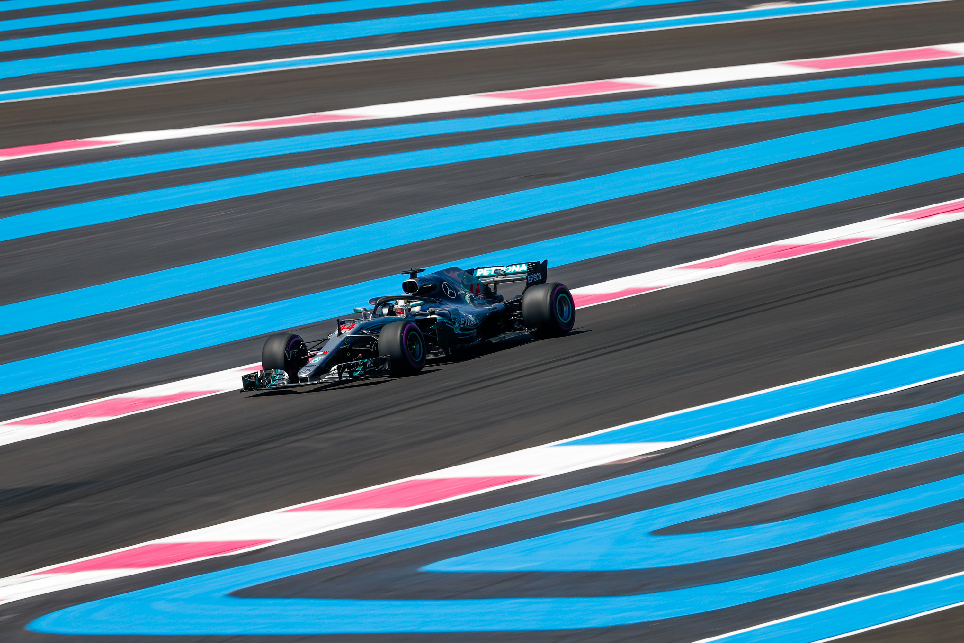
Thank you for your attention 🏁
🏁
https://www.circuitpaulricard.com/en/pages/tracks-and-facilities/

